Slide 1
SMM750 Group Assignment ONLINE WINE MARKET COMPETITOR ANALYSIS Group 5: Linh Nguyen (170037344) Soumya Ogoti (220045527) Wenxu Tian (210059418) Aparna Viswanathan (220004767) Fan Xia (200039922)

Slide 2




Data Selection
Consumer behaviour:
Why consumers purchase wine online?
Research objectives:
To understand product portfolio and business focus
Data Sources
Detailed description
Wine features:
type, country, year, ABV
Cheaper price
Wine price:
for a bottle of 75cL
More options
Wine reviews:
number of reviews, scores
Notes:
Student employability – Top 20 in the Times and Sunday Times University League Table
Student progression – 90% average across all undergraduate programmes
Student experience – consistently best National Student Survey results in London, top 20% in UK

Slide 3
Data Processing
BeautifulSoup
Data Scraping Approach
Web Scraping
Selenium
Choosing alternative website
Waiting or choosing alternatives
Anti -Scrapping
Website
crashes
Different webpage structure
Poor data quality
Customising the code
Manual adjustment
Notes:
Student employability – Top 20 in the Times and Sunday Times University League Table
Student progression – 90% average across all undergraduate programmes
Student experience – consistently best National Student Survey results in London, top 20% in UK

Slide 4
Variable Description
Variable | Description | Unit
name | Name of the wine
country | Country of the wine where it was produced
country_code | Country code of the wine where it was produced
wine_type | Type of the wine, e.g. red wine, white wine, sparkling wine, rosé wine etc.
year | Year when the grapes for the wine were harvested | Years
price_fixed | Listed price of the wine per bottle | Price in GBP (£)
logprice | Log price of the wine per bottle | Price in GBP (£)
scaled_price | Scaled price of the wine to 75 cL | Price in GBP (£)
score | Rating score of the wine | Lowest (0) to highest (5) rating
num_review | Number of reviews of the wine | No. of reviews
abv | Alcohol by volume, which measures alcohol content of wine | Percentage (%)
age | Age of the wine which is calculated by deducing year from current year (2022) | Years
size(cL) | Volume of the wine | cL
Notes:
Student employability – Top 20 in the Times and Sunday Times University League Table
Student progression – 90% average across all undergraduate programmes
Student experience – consistently best National Student Survey results in London, top 20% in UK

Slide 5
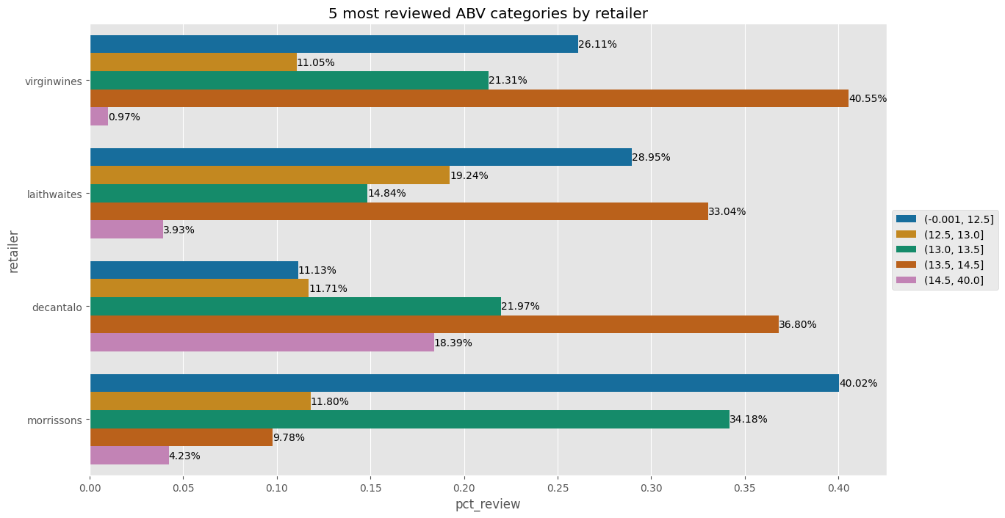
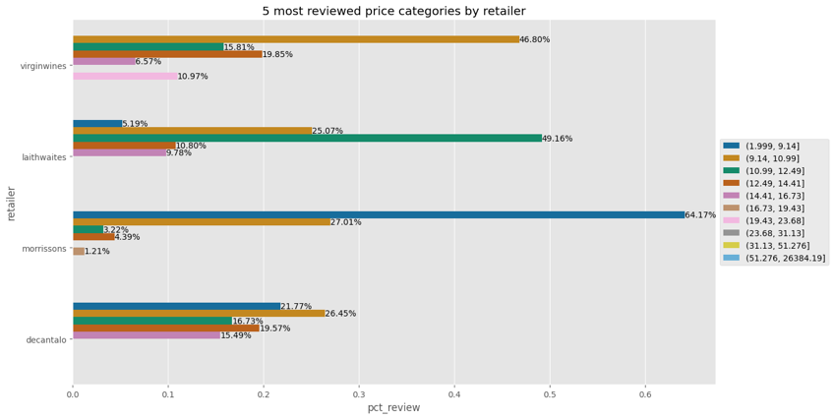
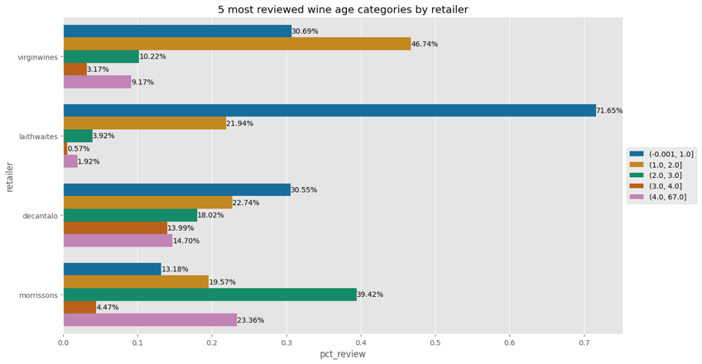
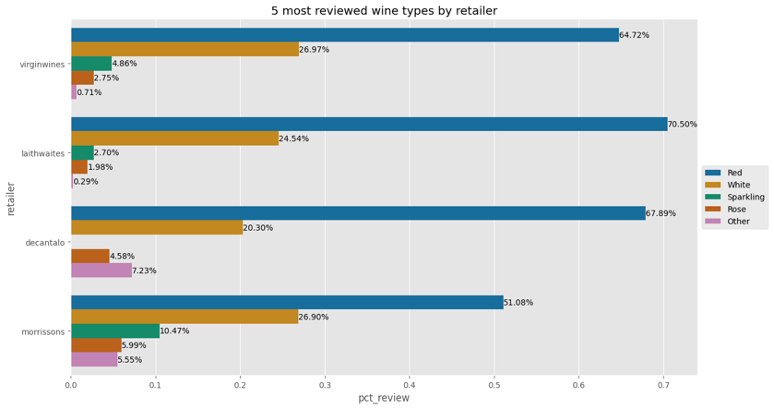
Data Visualisation
Abv below 12.5% and between 13.5% and 14.5% is preferred…
Set reasonable prices to target customers in different markets (mass vs niche)…
Wine age could be considered along with wine type and price…
Red wine, white wine, sparkling wine and rose wine are the most popular types…
Notes:
Student employability – Top 20 in the Times and Sunday Times University League Table
Student progression – 90% average across all undergraduate programmes
Student experience – consistently best National Student Survey results in London, top 20% in UK

